Slide 1
Puritan Literature in America

Slide 2
The Puritans
Definition: Group of Protestants who wanted to “purify” the Church of England.
Suffered persecution in England.
Small group led by William Bradford came to the New World on the Mayflower in 1620. Upon their arrival, they were met with harsh winters and unfamiliar terrain.
Established the first printing press, free public grammar schools, and the first American college (otherwise known as Harvard)

Slide 3
Puritan Beliefs
Most of humanity “damned” by the sin of Adam and Eve.
Predestination – God had already decided, before birth, whether someone would go to heaven or to hell
Values: self-reliance, hard-working, moderation, simple living, industrious, sobriety/temperance
Hard work resulted in material wealth, which indicated that a person was devoted to God.
The Puritans were considered Pilgrims because they viewed their emigration from England as a “spiritual journey.”

Slide 4
Puritan Politics
Rather undemocratic - felt that the “saintly elect” (in other words, religious leaders) should have had the most influence in politics
Church elders were also political leaders – any church rule violation was also a social one, and Puritan ministers always preached fear.

Slide 5
Puritan Politics
They used a Bible verse to justify when they needed something from the Native American people:
“Whosoever therefore resisteth the power, resisteth the ordinance of God: and they that resist shall receive to themselves damnation.”
Romans 13:2

Slide 6
Characteristics of Puritan Writing
Bible provided model - individual life is a “journey to salvation.” Connections between Biblical events and their own lives.
Used writing to explore their inner and outer lives for signs of God’s work.
Diaries and histories were most common.
Plain style stressed clear expression and avoided complicated figures of speech

Slide 7
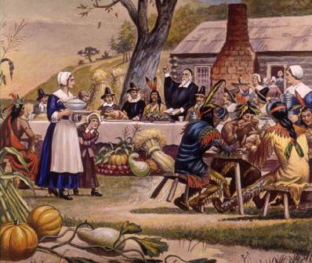
William Bradford
1590-1657
Of Plymouth Plantation
Described hardships of journey to New World; unshakeable belief in God.
Plain Style of writing - few figures of speech or metaphors.

Slide 8
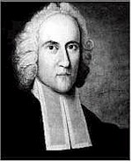
Jonathan Edwards
1703-1758
Famous sermon: “Sinners in the Hands of an Angry God”
“Fire and brimstone” imagery – everyone was going to hell!
Helped bring about the Great Awakening
Increased religious enthusiasm
Mass hysteria due to power of the messages
Accused prominent church members—by name—of sinning
Tyrannical pastor - extreme and strict – thought of humans as “lowly sinners.”

Slide 9
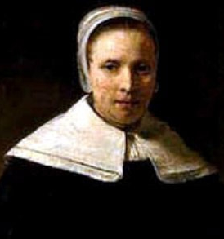
Anne Bradstreet
1612-1672
Came to America on one of the first ships from England
Her father and her husband were governors of Massachusetts
Her works explore religion, a personal relationship with God, and her husband (even though the love between a husband and wife was supposed to be repressed so that there was no distraction from a relationship with God)

Slide 10
Anne Bradstreet
Puritan society said that Anne’s “place” in life was “to be domestic, separated from the affairs of church and state,” getting her ideas from God and from her husband.
Anne was bothered by the Puritan bias toward women that was common in her time.
When her work was published, her brother-in-law had to tell people she was still a “good” woman, meaning that all her free time was still devoted to religious activities, and she wrote her poetry when she would have normally been sleeping.

